Slide 1
Time to Sign up!

Slide 2
1. Go to
csd4.edmodo.com
2. Click on I’m a Student

Slide 3
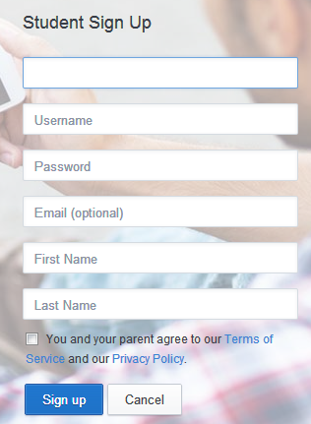
Student Sign Up
Group Code: TEACHERS: TYPE IN YOUR GROUP CODE HERE
Username: Computer login starting with S
Password: computer login password
Do not put in an email
Type in your first name and last name

Slide 4
Student Sign Up
Click the checkbox next to You and your parent agree to our Terms of Service and our Privacy Policy.
Click SIGN UP

Slide 5
Your Assignment on Edmodo:
Teachers, put directions for what they are to do when students have logged in here.

